Slide 1
MOWCAP Making Pacific History Visible Presenter: Dianne Macaskill, MOWCAP Vice-President

Slide 2
Overview of Presentation
About MOWCAP(Memory of the World Committee for Asia and the Pacific)
MOWCAP organisation structure
MOWCAP documentary heritage register
How to find information about MOWCAP
Contacts

Slide 3
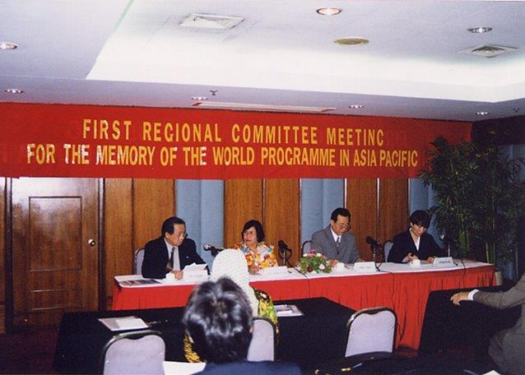
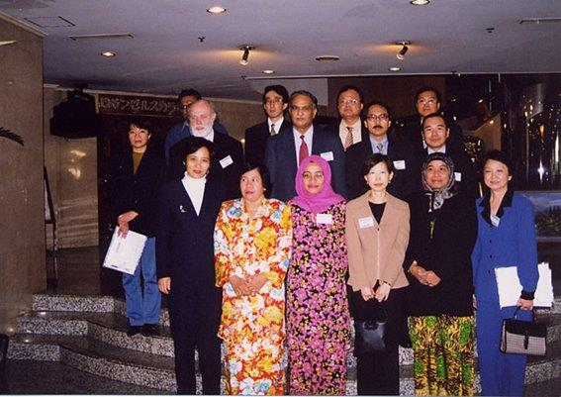
Establishment of MOWCAP
First MOWCAP General Meeting in Beijing in November 1998
First inscriptions on MOWCAP register in 2008
Significant voluntary input
)

Slide 4
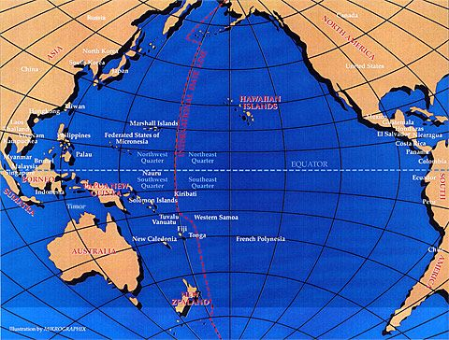
MOWCAP Region
MOWCAP is one of three Memory of the World regional committees (Africa, Latin America and Carribean)
The Asia Pacific region has 43 countries
North:Mongolia South:New Zealand West: Iran and the ‘stans’ East: Kiribati and the Cook Islands

Slide 5
Value of a Regional Committee (Source: MOWCAP Statutes)
Mobilise political, social and economic support and resources for the region’s documentary heritage
Encourage cross country linkages of collections with multi-country significance
Maintain the Asia and Pacific regional register of MoW documentary heritage
Mobilize resources and support for MoW projects and activities including bringing delegates of national M0W committees together for periodic meetings

Slide 6
How MOWCAP operates
Uses the Memory of the World Programme international General Guidelines but has adapted the register nomination process (section 8)
Composed of National MoW Committees
General Meeting of delegates from Member States every two years (not in 2020)
Each MOW Committee has one vote at General Meetings
Register Sub-committee makes recommendations to the General Meeting.
Bureau elected at every second meeting
Notes:
1.
.

Slide 7
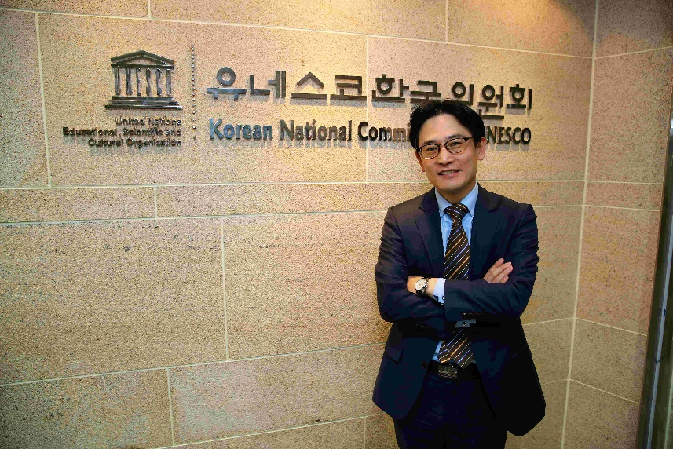
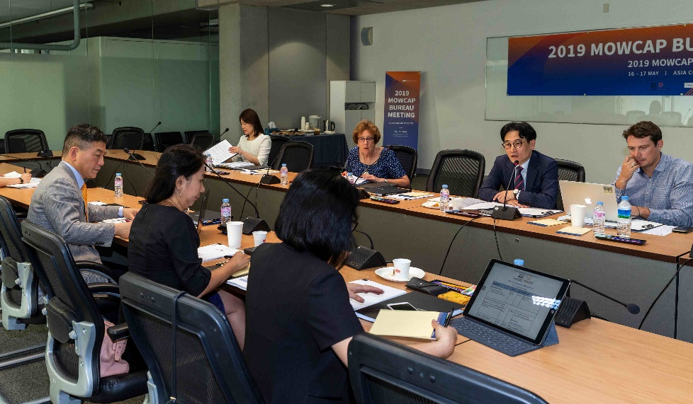
Introduction to the MOWCAP Bureau
Chair Mr. KIM Kwibae (Republic of Korea)
Vice-Chairpersons: Ms Dianne MACASKILL (New Zealand) Dr VU THI Minh Huong (Vietnam) Prof Mitsuru Haga (Japan)
Secretary General: Ms Linh Anh Moreau (Bangkok, Thailand)
UNESCO Ex-officio member: Mr Joe Hironaka (UNESCO, Bangkok)
MOWCAP is supported by a secretariat office hosted by the Korean Studies Institute in Andong, Republic of Korea
Bureau elections will be held at the General Meeting in 2024
Mr Kwibae Kim, Chair of MOWCAP
Bureau Meeting 2019

Slide 8
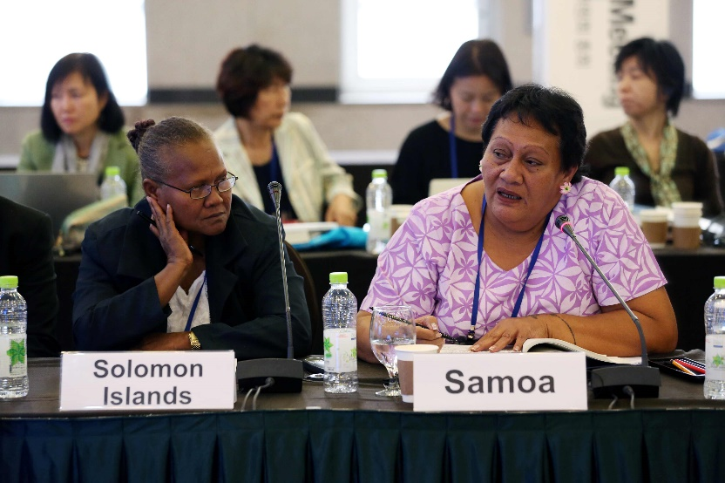
Register sub-committee Chairperson: Dr. Helen Jarvis (Cambodia)
Members:
Professor Kyung-ho SUH (Republic of Korea)
Ms Hongmin Wang (China)
Mr Opeta Alefaio (Fiji)
Professor Dr Aizharkyn Kozhobekova (Kyrgyzstan)
General Meeting
Margaret Inifiri, Amela Silipa General Meeting 2018

Slide 9
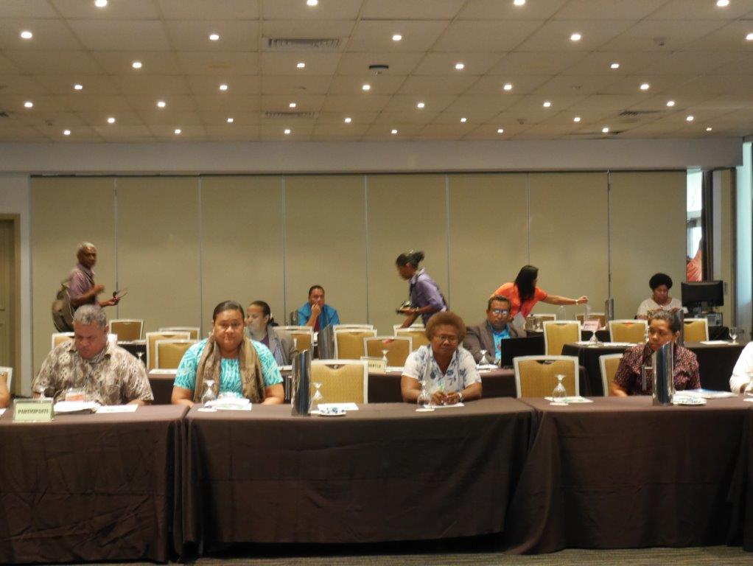
Pacific Stories are Important
Colonisation
Indentured labour
Migration
Independence
Culture
Exploration
Working on nominations – Fiji September 2016

Slide 10
65 inscriptions on the MOWCAP register
494 inscriptions on the international register (119 from Asia Pacific region)
I
Pacific Inscriptions on MOW
registers
Country | MOWCAP | International
Australia | 3 | 6
Cook Islands | 1
Fiji | 2 | 1
New Zealand | 2 | 3
Papua New Guinea | 1 | -
Samoa | 1 | -
Solomon Islands | 1 | -
Tuvalu | 1
Vanuatu | - | 1 (joint)
Total | 12 | 11
Note: Australia and Papua New Guinea have a joint inscription

Slide 11
MOWCAP
Register Guidelines
The MOWCAP Register Guidelines are consistent with but not the same as in the International Register Guidelines.
Some differences
The primary criteria for inscription reflect that significance is established on a regional basis
The General Meeting votes on whether the recommendation of the Register Sub-Committee is accepted or rejected
Read the register guidelines carefully before you start work on a nomination

Slide 12
MOWCAP
Register Guidelines
Some types of documentary heritage are not admissible to MOW registers (section D)
Examples include:
Papers of contemporary political leaders and political parties
National constitutions and similar documents
Vaguely described or open-ended nominations
Read the register guidelines carefully before you start work on a nomination

Slide 13
MOWCAP
Register Guidelines
Changes to the MOWCAP Register Process
Nominations must be submitted through the relevant National Commission with a letter of support
Nominations limited to three per country in each round. No limit on joint nominations
Nominations should be a maximum of 20 pages
Summaries of nominations accepted for assessment posted on the website and the nomination provided on request
Nominations can be contested on technical and other grounds (a complex process and recommend discussing with a MOW expert if guidelines need further explanation)
Other
Nominators are encouraged to identify any aspects that relate to gender equality
Joint nominations are encouraged
Read the register guidelines carefully before you start work on a nomination

Slide 14
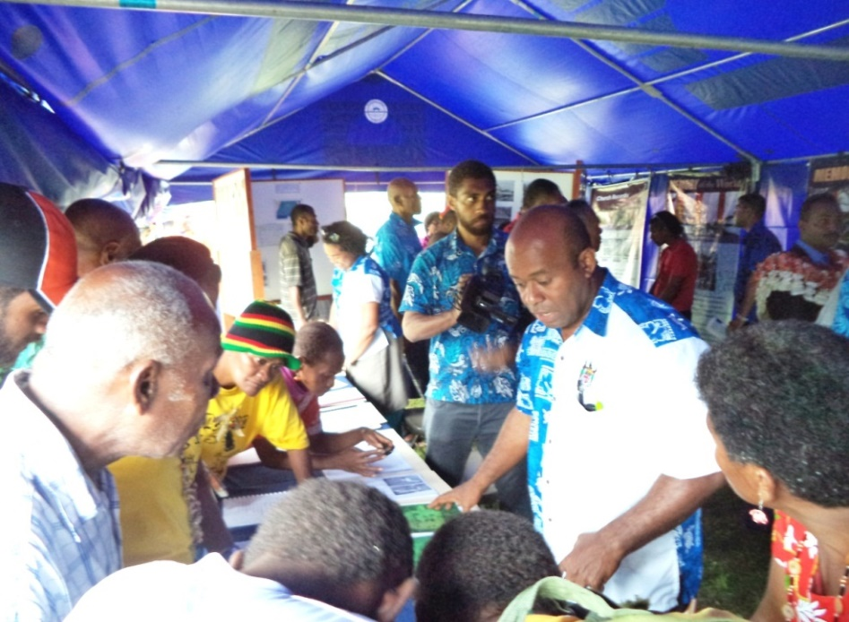
Records of the Indian Indentured Labourers (Joint nomination Fiji (primary nominator), Guyana, Suriname Trinidad and Tobago; international register 2011)
Over a period of roughly 100 years 1,194,957 Indians were relocated to 19 colonies. These records are the only documents for ancestral and lineage research for the numerous descendants of those Indian Labourers.
.
Photo shows a travelling archive exhibition in Fiji to reconnect residents with ancestors of Pacific Islands Labourers. The labourers were indentured as plantation workers during the labour trade from 1876 – 1914. The Polynesian Immigrants Records 1876-1914 were inscribed on the MOWCAP register in 2014.

Slide 15
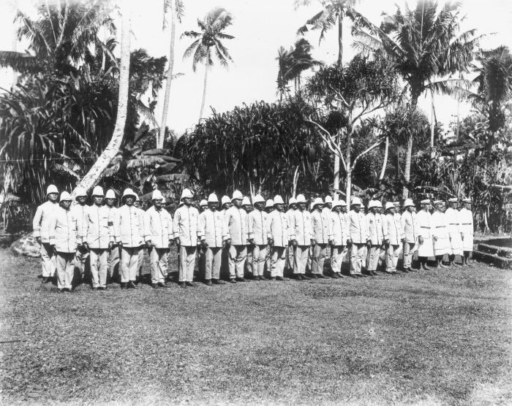
Archives of German-Samoa Colonial Administration (Samoa 2014)
Provide a unique picture of German colonial expansion in the Pacific
German missionaries changed the nature of Samoan social relationships
Provide insights into the politics and personal views of colonists leading up to World War 1
Notes:
Example of impact Missionaries had across the Pacific

Slide 16
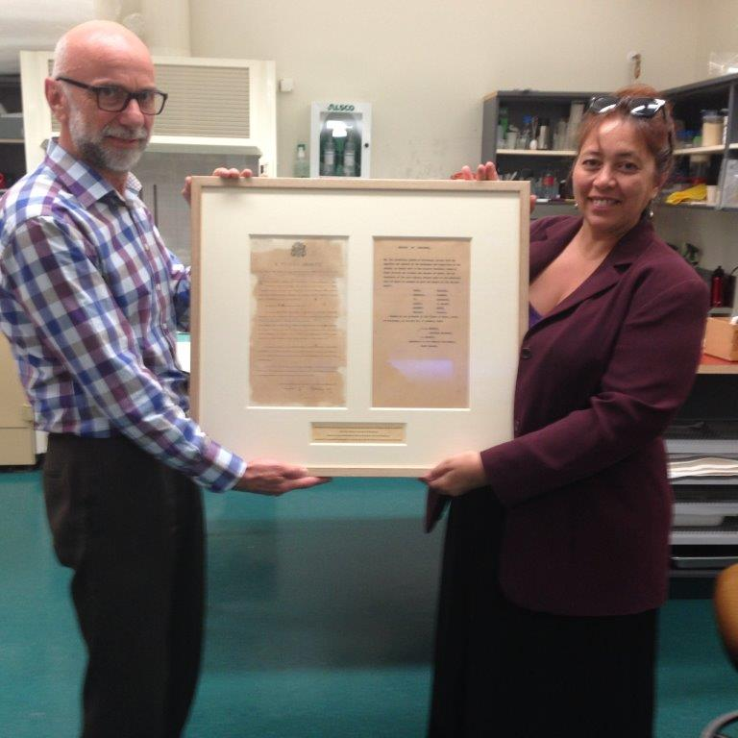
E Tutatua Akakite Cook Islands Proclamation (2014)
A fragile and rare, two page document, written in Maori, the language spoken in the Cook Islands (1891)
Sought the protection of the British against French interests
Made the Cook Islands a protectorate of Great Britain
David Ashman and Jean Mason with Cook Islands proclamation post conservation on 7 Jan 2015

Slide 17
Information and Who Can Help Support Your Nomination
Keep up to Date With MOWCAP Activities
MOWCAP website www.mowcapunesco.org
MOWCAP Facebook page
Newsletter – email mowcapinfo@gmail.com and ask to be added to the contacts list
MOWCAP Youtube Channel
Help with a Nomination
Dianne Macaskill dianne.macaskill@gmail.com
Ros Russell russell598@hotmail.com
Opeta Alefaio technical questions Opeta.Alefaio@anu.edu.au

